Slide 1




Childhood Adversity’s Impact on Dynamic Mental Health During and Post Pregnancy
A Causal Discovery Approach
Jennifer Yu*, Mai Ali, Parinita Edke, Rui Zhu, Anna Goldenberg

Slide 2
Motivation

Slide 3
Global Prevalence of Depression
26.3%
28.5%
27.5%
Antenatal Depression
(Before birth)
Prenatal Depression
Postpartum Depression
Notes:
As you may know from everyday news and people around you, depression is reported as the most common mental health disorder during pregnancy.
According to a recent study conducted in 2023, the mean of the global prevalence of depression during the prenatal period is 28.5%, as opposed to 27.5% and 26.3% in postnatal and antenatal (before birth) periods respectively
Although the prevalence of depression during and after pregnancy is almost similar, prenatal mental health has received less research focus than postpartum depression

Slide 4


Depression and Anxiety
41.6%
Depression
Anxiety
2 : 1
Notes:
Besides depression, anxiety is another major mental disorder during pregnancy.
Both anxiety and depression are more widespread among women, with a ratio of approximately 2:1 compared to men during women’s reproductive years.
Furthermore, depression and anxiety often coexist. 41.6% of those diagnosed with major depression are also facing anxiety disorders within a year.

Slide 5
Adverse Childhood Experience
1
chronic obstructive pulmonary disorder
2
ischemic heart disease
Negative Health Outcomes
3
major depression disorder
4
general anxiety disorder
Notes:
So, what might be the cause for depression and anxiety? It was found that Adverse childhood experience (ACE) prior to the age of 18 has been associated with several negative health outcomes in the future such as chronic obstructive pulmonary disorder, ischemic heart disease, major depression disorder and general anxiety disorder.
There is limited knowledge of how those mental health conditions manifest during pregnancy.
There is a lack of understanding regarding the specific patterns of interaction between mental and physical health during pregnancy

Slide 6
Research Objectives
ACEs⇠⇢ Depression, Anxiety, Quality of Life
How adverse childhood experiences affect pregnancy related depression, anxiety and quality of life
Mental Health Symptoms
The intricate relationships among mental health symptoms that occur during and post pregnancy
Physical Health⇠⇢ Mental Health
Investigate the relationship between physical and mental health during pregnancy and post pregnancy

Slide 7
Methodology

Slide 8
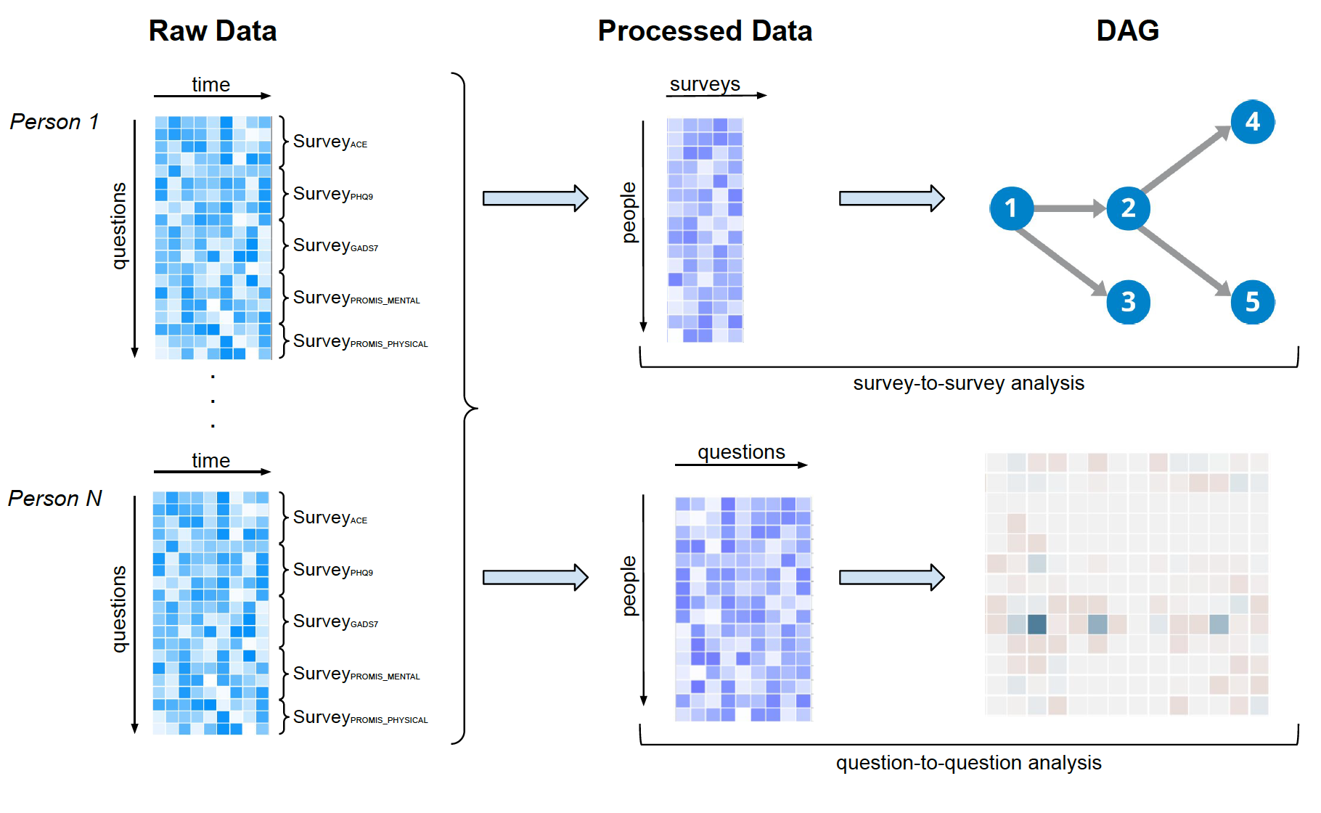
Algorithm Overview
Notes:
We first start with some raw data collected from 5 different surveys, ACE (adverse childhood experience) survey, PHQ9 (depression survey), gad7 (anxiety survey), PROMIS Global mental and physical (mental and physical well-beings). After that, we perform data preprocessing which I’ll go into details next, then we get one value per survey per person, OR one value per question per person. Lastly, we applied causal discovery algorithm to find a DAG that can present associations between nodes, where each node could be a survey if survey-to-survey analysis is performed OR each node could be a question if question-to-question analysis is performed.

Slide 9
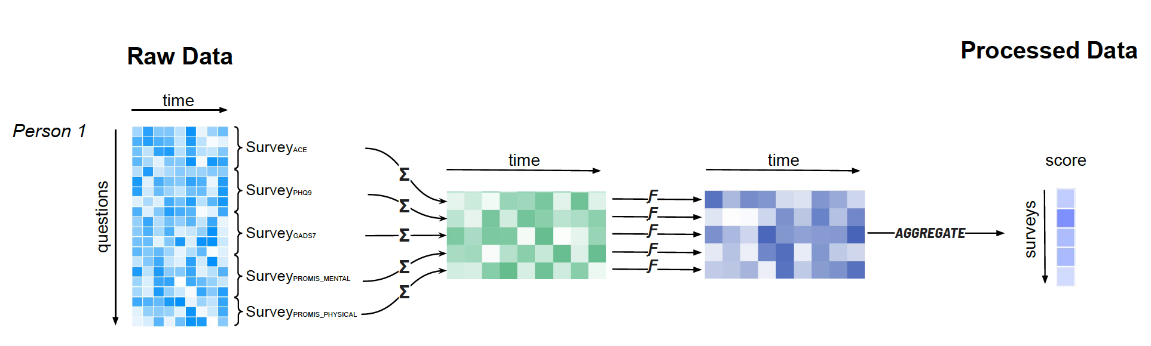
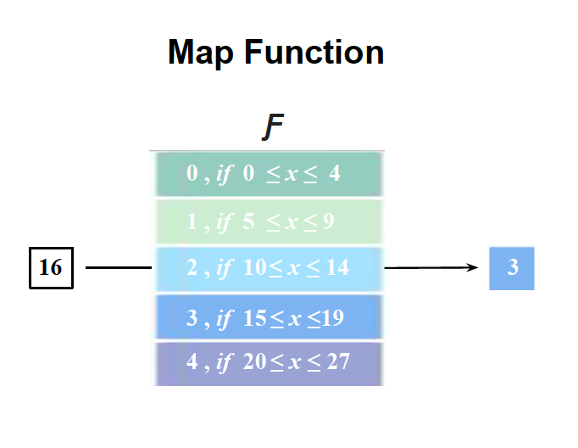
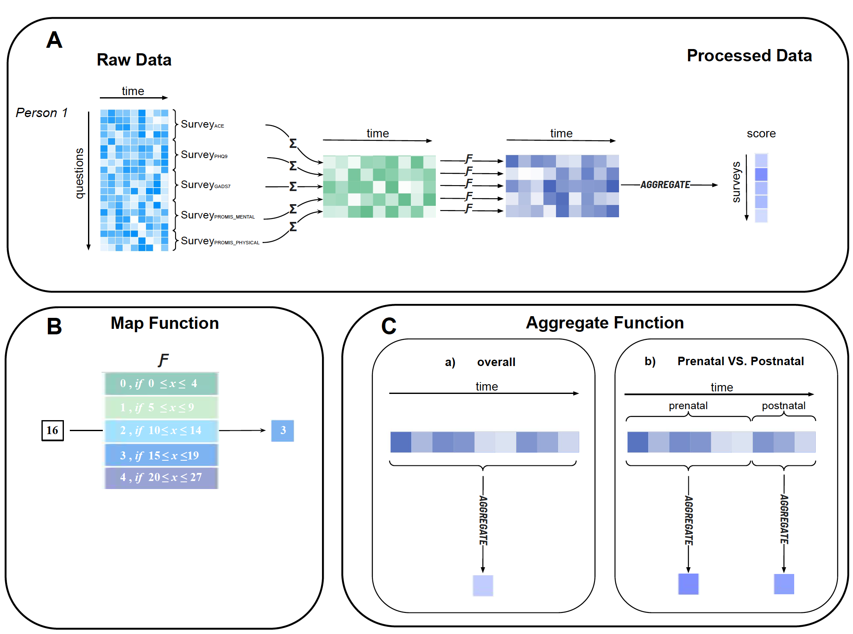
Data Preprocessing – Survey-to-survey Analysis
Notes:
For data preprocessing, we sum up all the questions in each survey and apply a function F to categorize all the score sum into meaningful categories. The function for each survey follows literature standards. For example, if the ACE total score is below a certain threshold, it can be considered low or likely no ACE. If it’s above a certain threshold, then it can be considered had ACE during childhood. Next, an AGGREGATE function can be applied across time (e.g., mean, median, max, or min). Here, we chose mean across time. Two approaches can be used when doing the aggregate step. One is that we can aggregate across all time (both prenatal and postnatal), the other is that the total time can be broken down into prenatal and postnatal periods and we can perform prenatal and postnatal separately.

Slide 10
Algorithm Overview

Slide 11

DAG Algorithms
PC Algorithm
DAG with NO TEAR
Constraint-based method that starts with a complete, undirected graph and deletes edges recursively based on conditional independence tests
This will give a graph skeleton with no directions.
The skeleton can be extended to a complete partially DAG (CPDAG) where ambiguous causal directions can go both ways.
Assumption: no hidden confounders
Score-based method that optimizes a loss function with the constraint of a DAG.
Given a data matrix $Χ∈ℝ^{n×d}$, it optimizes a loss function:
$$\min_{G}{Loss\left(W\right)}$$
$$subject to G\left(W\right)∈DAGs$$
where $W∈ℝ^{d×d}$ is the weighted adjacency matrix inducing $G\left(W\right)$
Solving this will yield a DAG.

Slide 12
Results

Slide 13
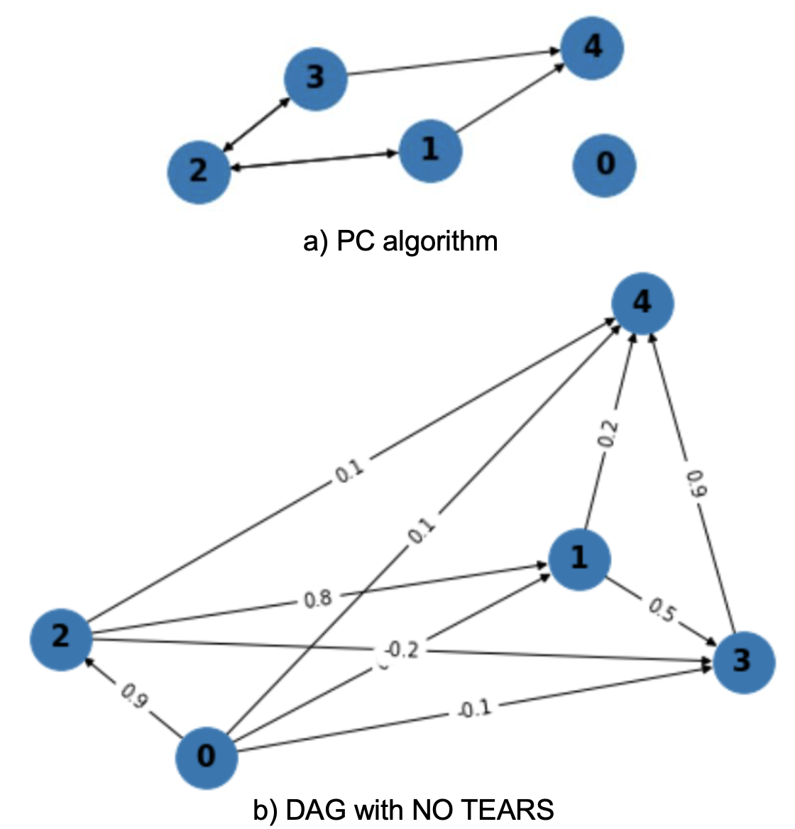
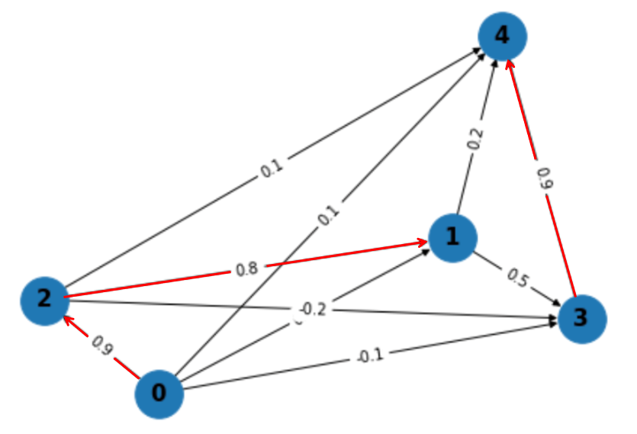
Survey-to-survey Analysis - Overall
0: ACE, 1: Depression, 2: Anxiety, 3: Mental Well-being, 4: Physical Well-being
DAG with NO TEARS algorithm yields more reasonable results based on consultation with domain experts
Strongest relations are from
ACE -> Anxiety (0.9)
Anxiety -> Depression (0.8)
Mental Well-being -> Physical Well-being (0.9)

Slide 14
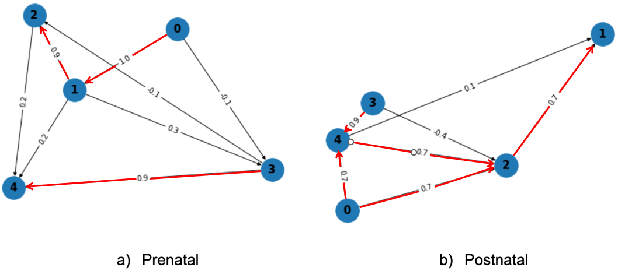
Survey-to-survey Analysis – Prenatal VS. Postnatal
ACE ⬄ depression & anxiety during both pre- and postnatal periods. This finding is consistent with two other studies.
Prenatal: ACE ⬄ depression (strong association)
Postnatal: ACE ⬄ anxiety (strong association)
Both stages: depression⬄ anxiety (strong association)

Slide 15
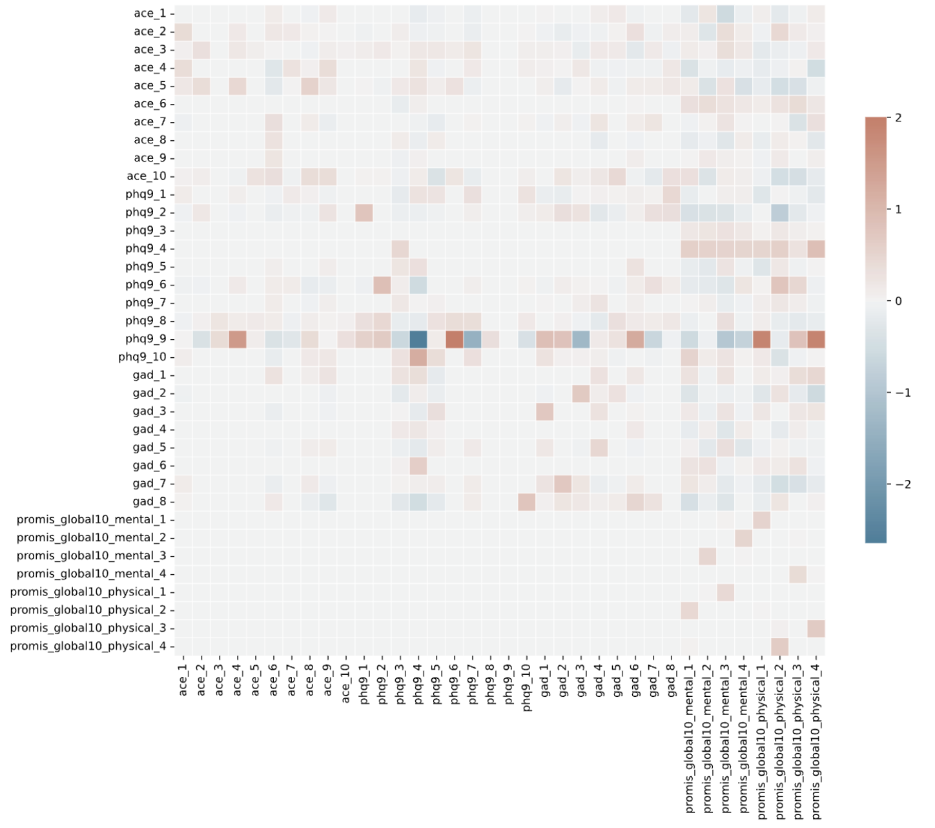
Question-to-question Analysis - Overall
DAG is generated from the DAG with NO TEARS algorithm.
Question 9 from the PHQ-9 survey exhibits stronger edge weights than other questions
PHQ-9 q9 pertains to suicide risk, asking about thoughts dead in the past two weeks..

Slide 16
Question-to-question Analysis – Prenatal VS. Postnatal
Both stages: PHQ-9 q9 still exhibits stronger edge weights than other questions
Prenatal: PHQ-9 q9 ⬄ PHQ-9-q6 (trouble falling asleep , or sleeping too much)
Postnatal: PHQ-9 q9 ⬄ PROMIS_GLOBAL10_PHYSICAL-q4 (rating your pain on average)

Slide 17
Conclusion
Study Overview
1
Our study explores the varying impact of Adverse Childhood Experiences (ACE) on mental health during pregnancy and postnatal periods, finding that the effects differ between these stages.
Limitations
2
The results are influenced by the rarity of extreme measures, unmeasured factors, and potential confounding elements which may skew the independence tests and obscure the clear understanding of causal relationships.
Impact & Future research
3
This research paves the way for developing clinical interventions to improve maternal mental health during pregnancy and postpartum, while also underlining the need for further studies to clearly understand the direct and indirect effects of ACEs on mental health during these periods.

Slide 18






Acknowledgment
Collaborators
Supervisor
Teammates
Mai Ali, PhD Candidate
Dr. Stephen Friend
Rui Zhu, MSc Student
Dr. Anna Goldenberg
Dr. Sarah Goodday
Parinita Edke, MSc Student

Slide 19
Thanks you for listening! Any questions?

